Slide 1


K.RAMAKRISHNAN COLLEGE OF TECHNOLOGY (AUTONOMOUS), TRICHY
BULK FILE RE NAMER
PRESENTED BY
S.ROHITH
(2303811720521042)

Slide 2
PRESENTATION OVERVIEW
Problem Identification Objective Implementation Methodology
Module Description Python Library Functions Used Flow diagram Hardware and Software Requirements Implementation Level

Slide 3
PROBLEM IDENTIFICATION
The problem of bulk file renaming arises when users need to rename multiple files simultaneously, often to maintain consistency, improve organization, or adhere to specific naming conventions. Manually renaming a large number of files can be tedious, time-consuming, and error-prone. Therefore, the need for an automated solution or specialized software arises.
2/7/20

Slide 4
OBJECTIVE
The objective of a bulk file renamer is to automate the process of renaming multiple files simultaneously, based on specified criteria or rules. The primary goals of implementing a bulk file renamer

Slide 5
IMPLEMENTATION METHODLOGY MODULE DESCRIPTION
INPUT MODULE:
Responsible for collecting user input, such as the directory path containing the files to be renamed and the renaming criteria.
Handles input validation to ensure that the provided
parameters are valid and appropriate for the renaming
operation.
RENAMEING LOGIC MODULE:
Handles potential errors that may occur during the
renaming process, such as file conflicts, permission
issues, or invalid input.
Provides robust error-handling mechanisms to ensure graceful handling
of errors without interrupting the renaming process.

Slide 6
PYTHON LIBRARY FUNCTIONS USED
1.Operating System Interface
os.listdir(): Used to get the list of files in a directory. os.rename(): Renames a file or directory. os.path.join(): Joins paths intelligently to handle different operating systems.
2.Regular Expression
Used for pattern matching and manipulation of file names.
Functions like re.sub() can be used for search and replace operations.

Slide 7
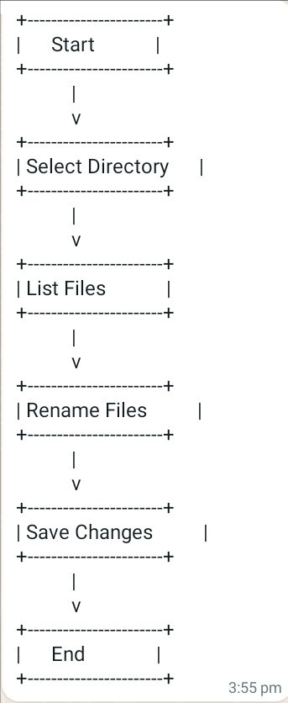
FLOW DIAGRAM

Slide 8
HARDWARE AND SOFTWARE REQUIREMENTS
HARDWARE REQUIREMENTS :
SOFTWARE REQUIREMENTS :
PROCESSOR:
Intel Core i3
AMD Ryzen
OPERATING SYSTEM :
Windows, macOS, and Linux.
RAM:
PYTHON LIBRARIES:
4GB RAM
os, shutil, glob, re, pathlib, argparse, logging
STORAGE:
HDD, SSD, network storage

Slide 9
IMPLEMENTATION LEVEL
At the implementation level, the input module for a bulk file renamer in Python is responsible for collecting user input, such as the directory path containing the files to be renamed and the renaming criteria. Here's how you can implement the input module
At the implementation level, the renaming module for a bulk file renamer in Python is responsible for applying the specified renaming criteria to each file in the directory. Here's how you can implement the renaming modul

Slide 10
THANK YOU

